Slide 1
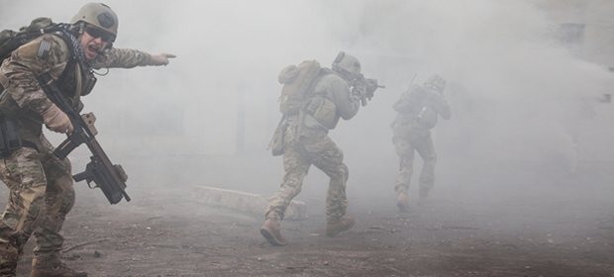
Fog of War
Ferran Martín Vilà

Slide 2
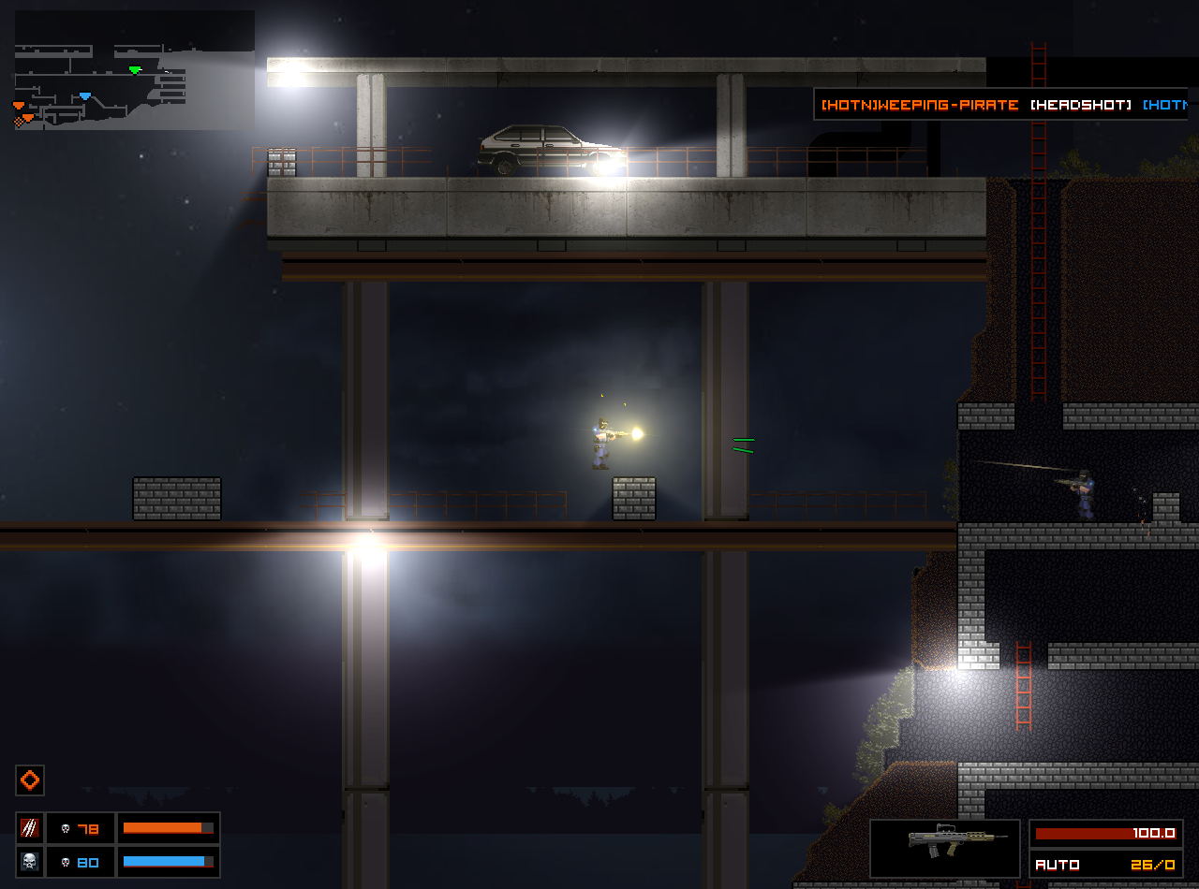
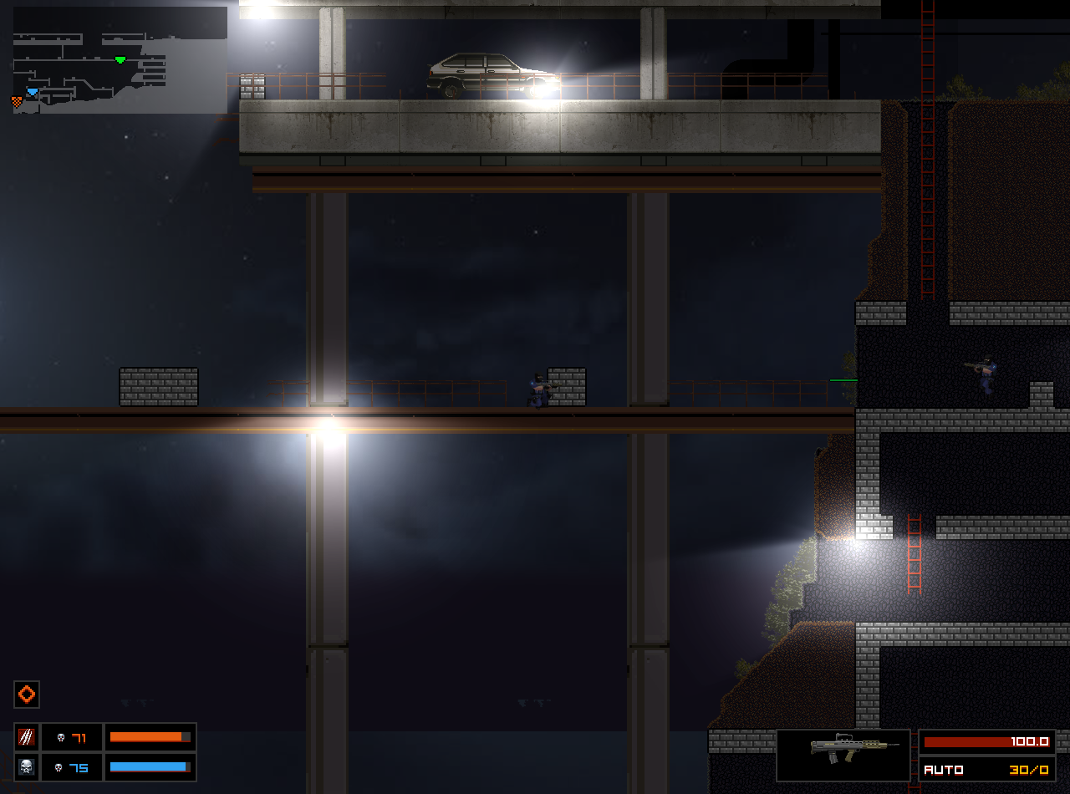

Concept:
Fog of war is not fog ?

Slide 3
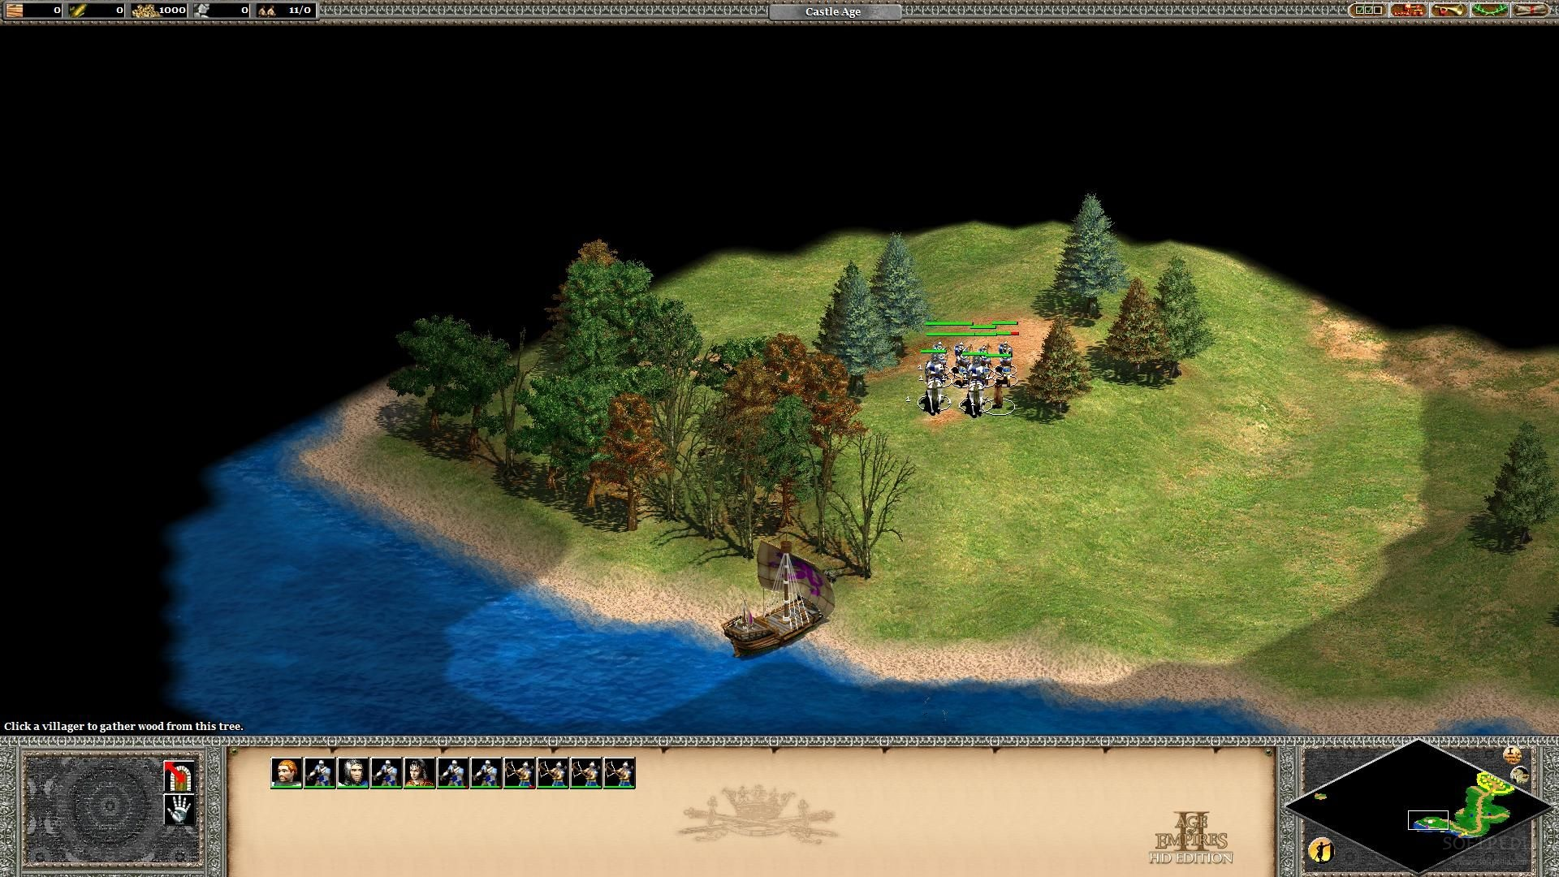
Types:
- Grand Strategic: We don’t know anything about the enemy.

Slide 4
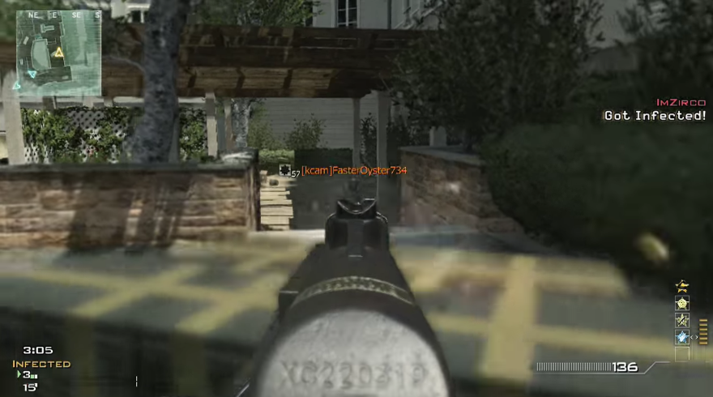
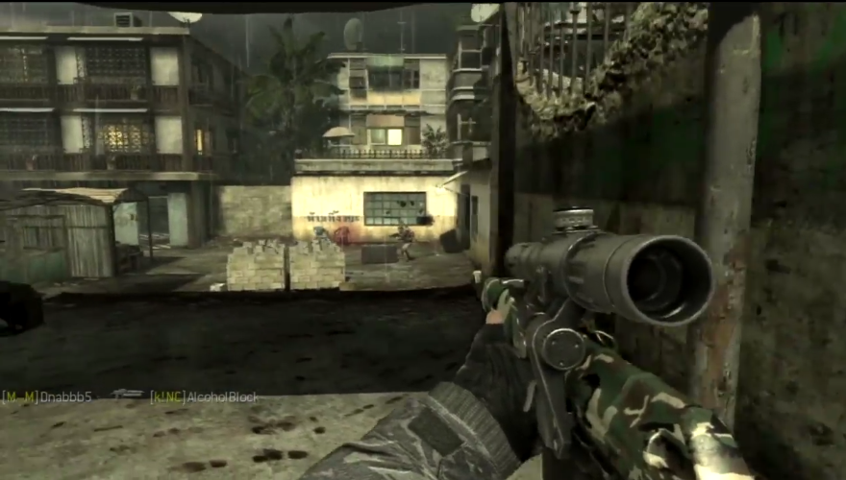
- Military Strategic: Ambiguity in strength and disposition.

Slide 5
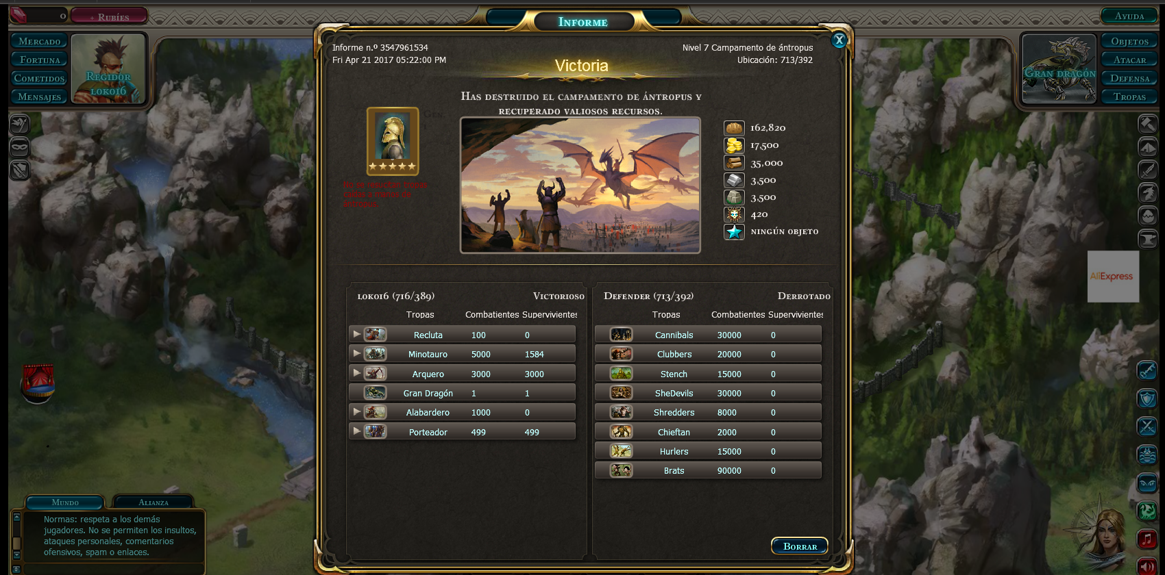
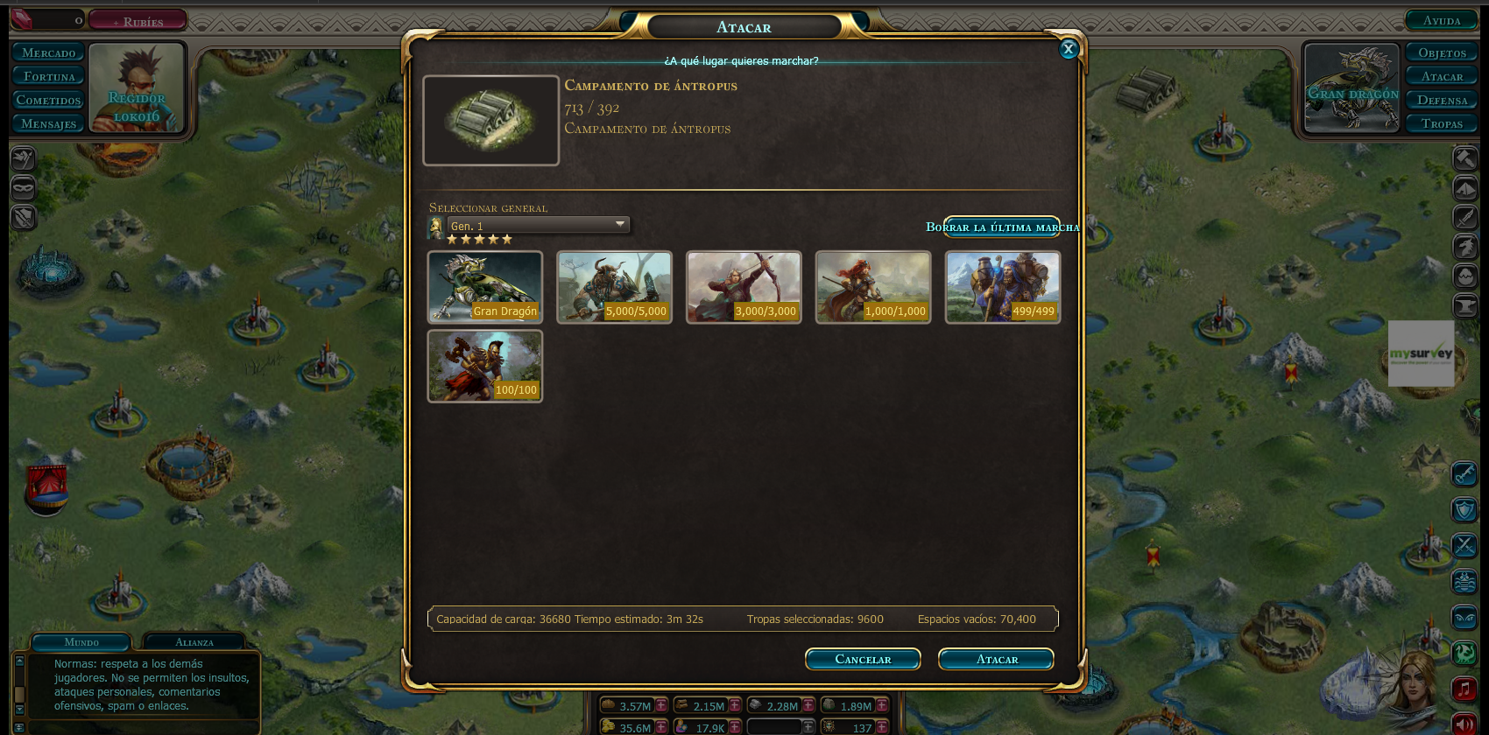
- Operational: Own directive ambiguity.

Slide 6
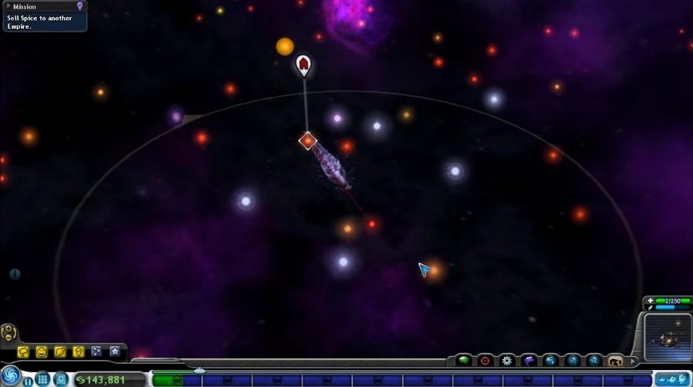
- Tactical: Lost of contact.

Slide 7
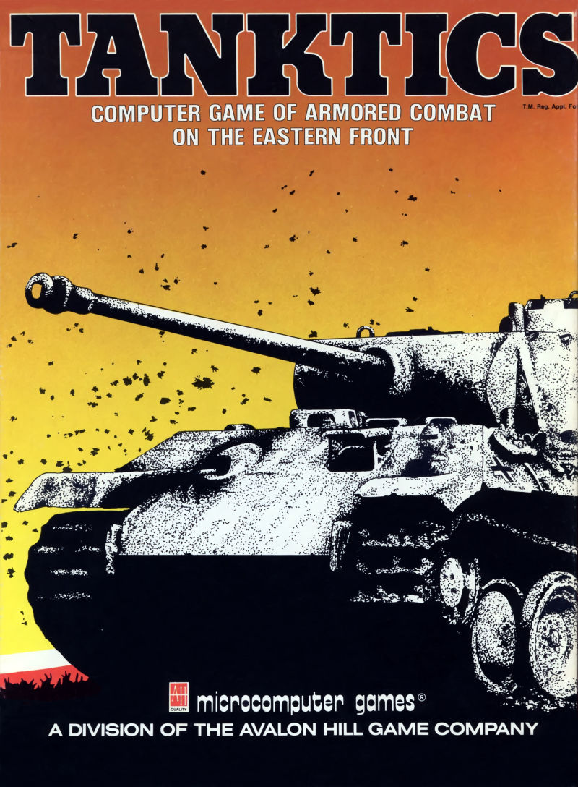
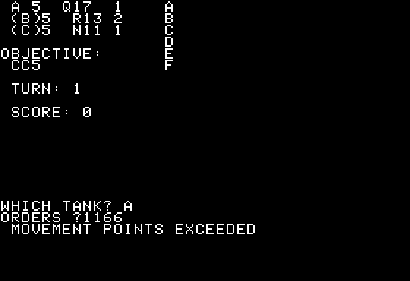
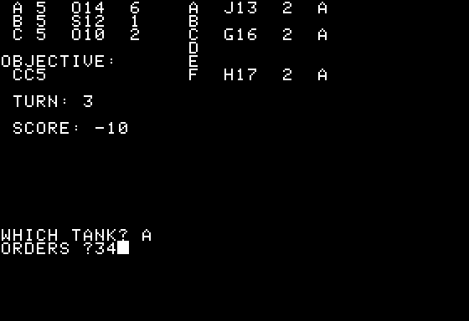
- Origins:
- First game with fog of war!

Slide 8
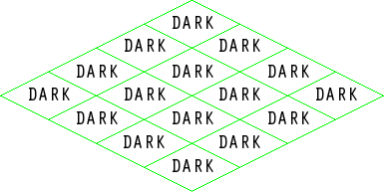
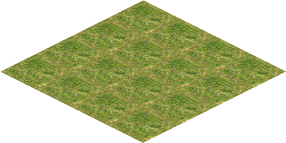
Todo 1
Create fog layer! (logic layer)
- Same size as map.

Slide 9
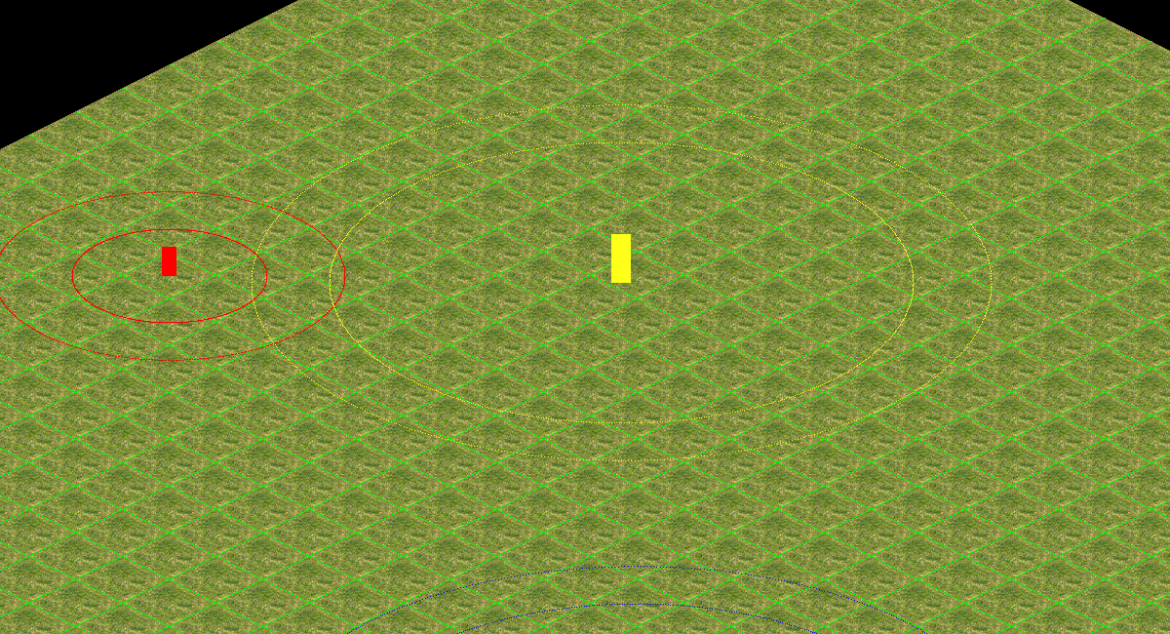
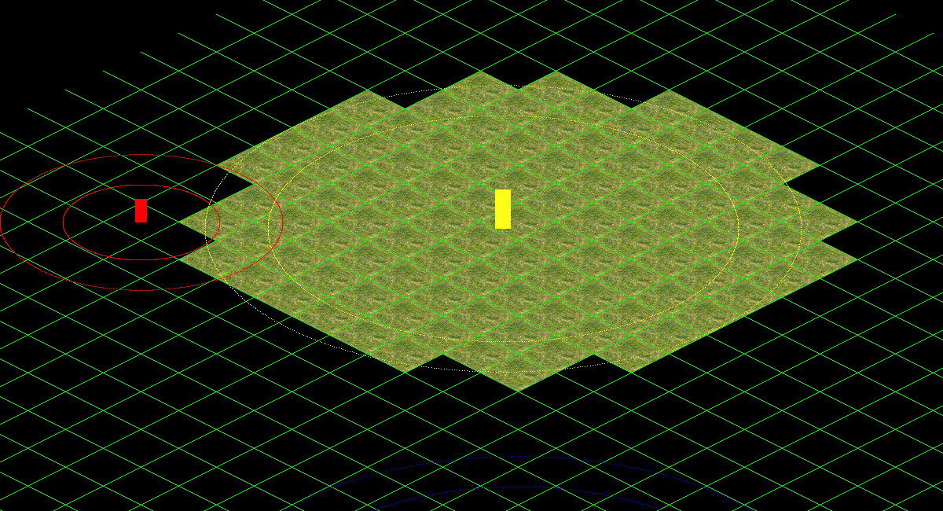
Todo 2
- Map Optimization!
- Improve the GetFogID method!
- If a tile is under DARK_FOG don’t render it!

Slide 10
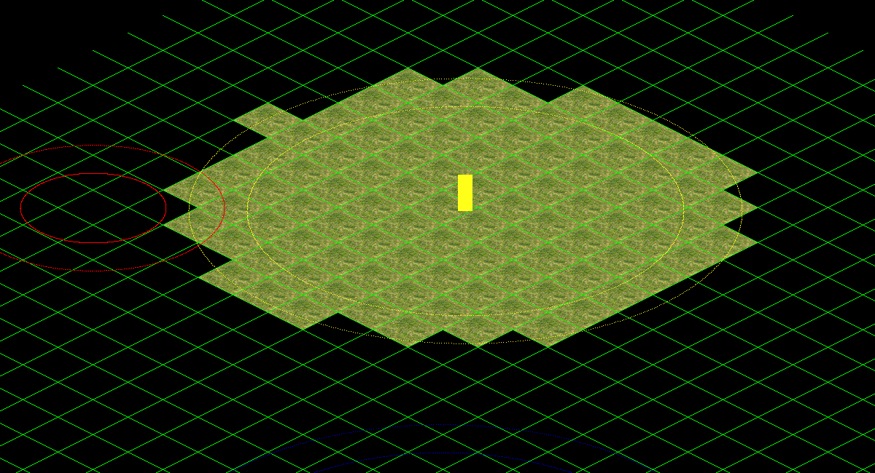
Todo 3
- Entities draw optimization!
- ALLY entities are always drawn
- NEUTRAL entities are not drawn when FOG_TYPE is DARK_FOG
- ENEMY entities are only drawn when there’s NO_FOG

Slide 11
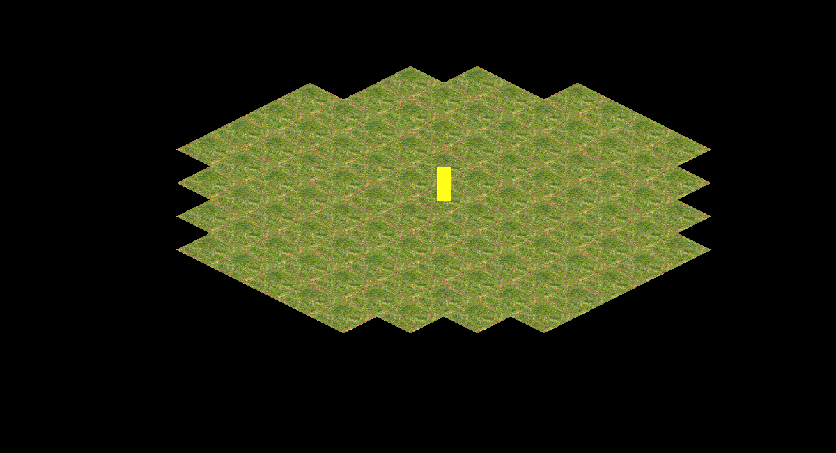

Todo 4
Draw alpha layer!
- Collect the candidates of the fog_quadtree
- Call FogBlit method from render module
- Use app debug mode to activate/deactivate the fog draw (F1)

Slide 12
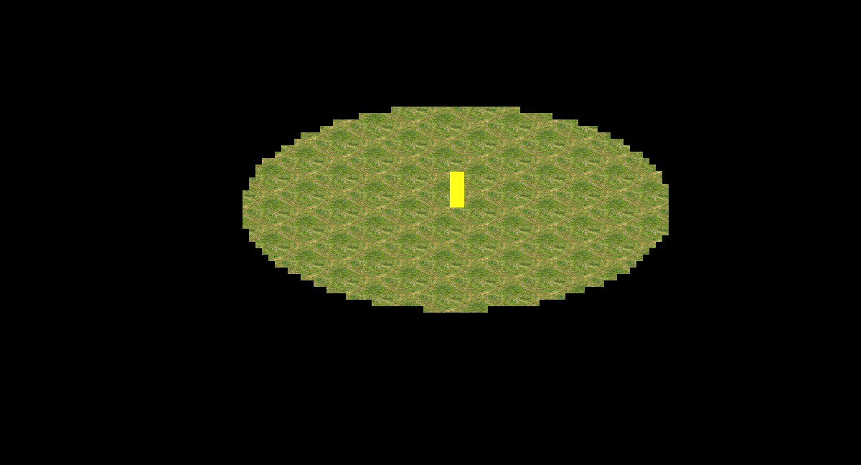
Todo 5
- Make ALLY entities clear alpha layer!
- Use ClearAlphaLayer method with 0 alpha value

Slide 13
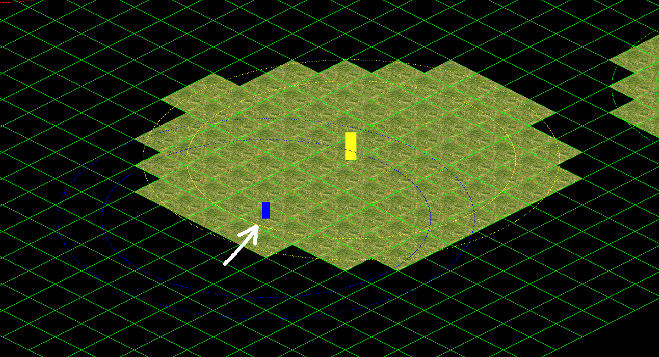
Todo 6
Make player check his vision area!
- Fill CheckVisionArea entity method and call it from player update

Slide 14
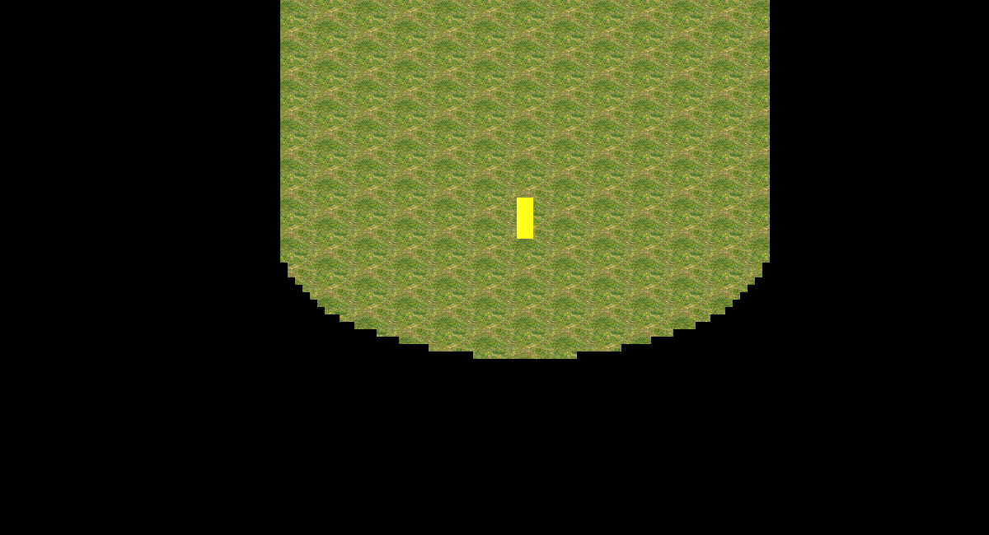
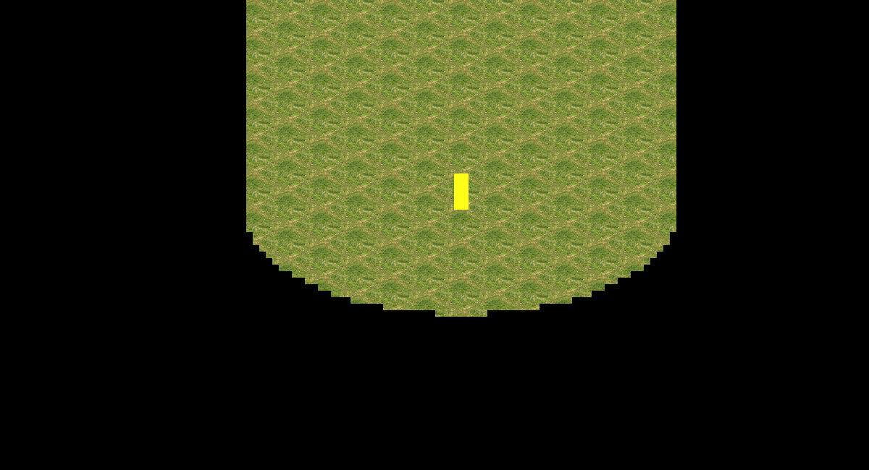
Todo 7
- Clear fog area when a neutral entity is detected!
- Use ClearAlphaLayer method with MID_ALPHA value
- Use ClearFogLayer method with GRAY_FOG value

Slide 15
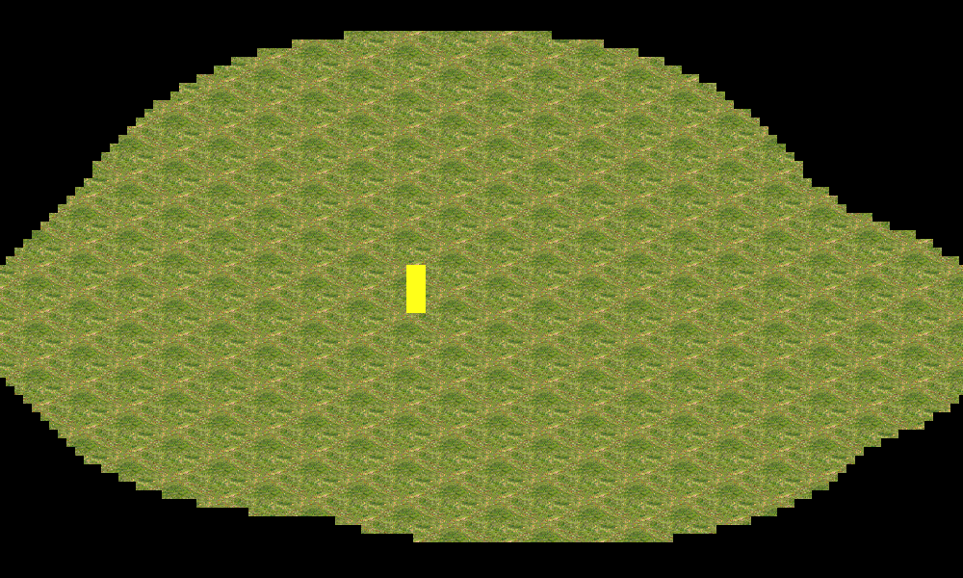
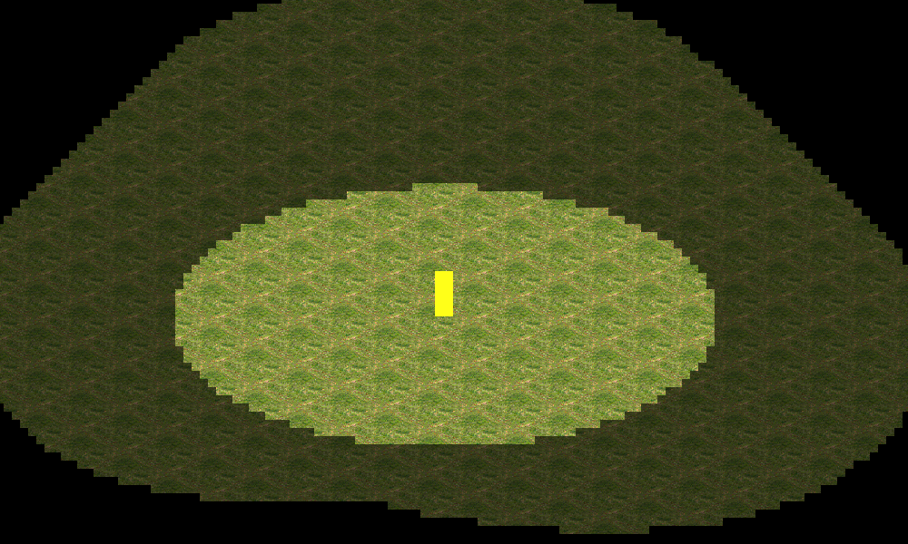
Todo 8
- Update alpha layer!
- Check if there’s any AlphaCell in camera with alpha < MID_ALPHA value

Slide 16

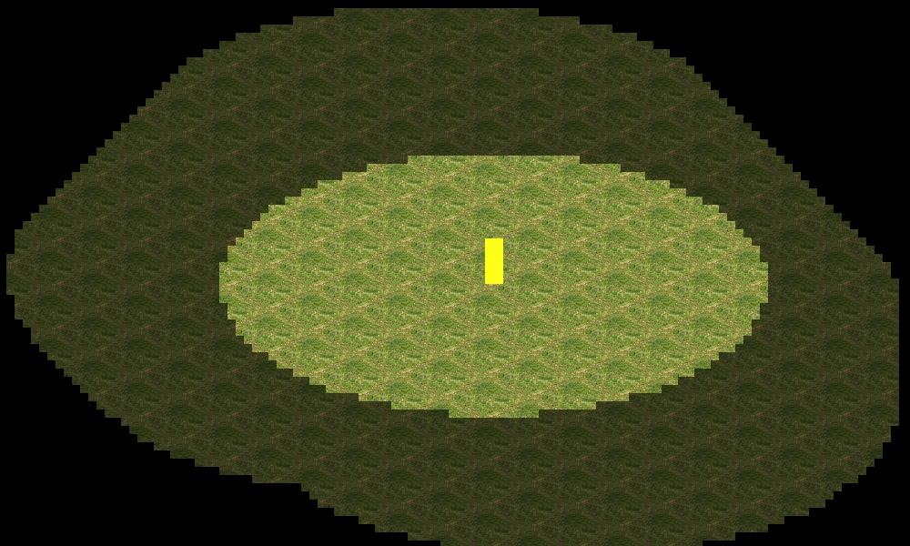
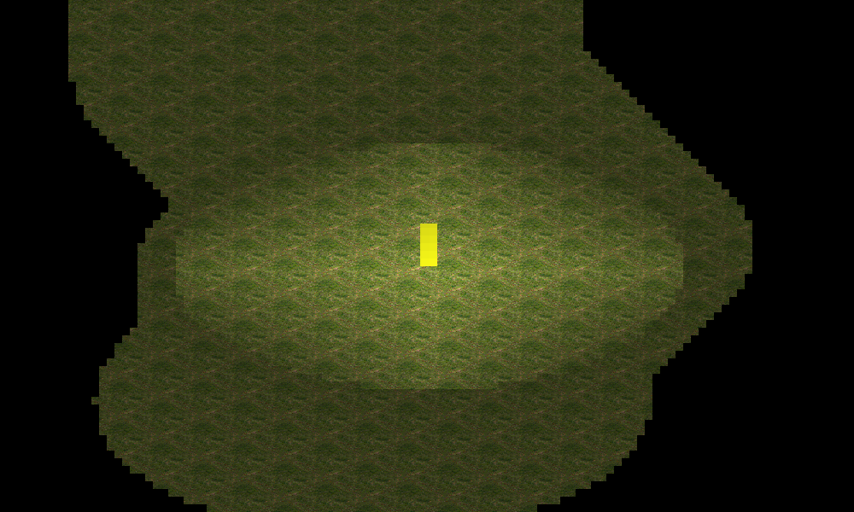
Extra Work!
- Create a function to smooth the fog alpha layer and iterate it!

Slide 17
More Info…
http://dictionary.sensagent.com/Fog%20of%20war/en-en
https://en.wikipedia.org/wiki/Wargaming#Early_years_to_Kriegsspiel
https://archive.org/details/Tanktics_1981_Avalon_Hill
http://stackoverflow.com/questions/13654753/sdl-drawing-negative-circles-fog-of-war

Slide 18

And that's it!
Contact me!
GitHub: https://github.com/ferranmartinvila
Gmail: ferranmartinvila21@gmail.com

